Slide 1



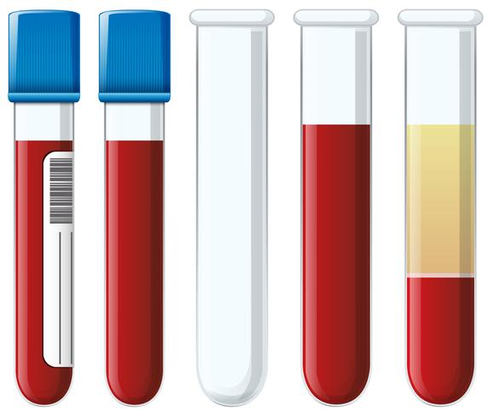
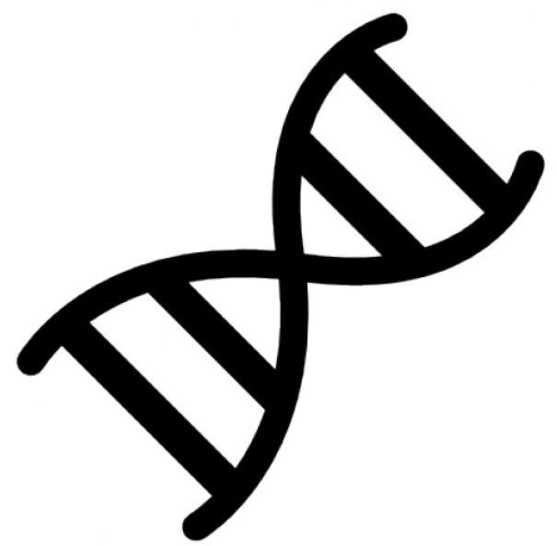




Utility of Circulating Tumour DNA in Ewing Sarcoma
Smadar Kahana-Edwin¹, James Torpy², Lucy E. Cain³, Anna Mullins³, Geoffrey McCowage³, Leonard Goldstein², Jonathan Karpelowsky^{1,4,5}
¹ Advanced Molecular Diagnostics, Children’s Cancer Research Unit, Kids Research, The Children’s Hospital at Westmead, Sydney, NSW, Australia; ² Computational Biology Group, Kinghorn Centre for Clinical Genomics, Garvan Institute of Medical Research, Sydney, NSW, Australia; ³ Cancer Centre for Children, The Children’s Hospital at Westmead, Sydney, NSW, Australia; ⁴ Paediatric Oncology and Thoracic Surgery, The Children’s Hospital at Westmead, Sydney, NSW, Australia; ⁵ Division of Child and Adolescent Health, The University of Sydney, Sydney, NSW, Australia
Background
Approach
Conclusions (Part 1)
New risk-stratification markers to identify patients with Ewing sarcoma (ES) unlikely to benefit from standard therapy as well as to monitor treatment response to new agents are an unmet need in ES cancer care.
Liquid biopsy is an emerging method to detect shed cancer biomolecules in body fluids and its clinical usefulness is being investigated for diagnosis of different diseases and conditions, including cancer treatment response.
We developed and assessed custom digital next generation sequencing (NGS) assay that captures intronic regions of EWSR1 (covering the most common translocations, occurring in 85% of cases) as well as the coding regions of STAG2 and TP53, to detect mutations in the circulation of patients diagnosed with ES.
ctDNA mutations were detected in samples taken from patients at: initial diagnosis in 4/8 (50%, 3/5 localised and 1/3 metastatic), post-neoadjuvant chemotherapy in 1/4 (25%), post primary resection in 0/2 (0%), and recurrent disease in 0/3 (0%), suggesting a positive correlation between ctDNA and tumour burden. EWSR1 fusions were detected in 2, STAG2 loss-of-function mutations detected in 4, and TP53 mutations detected in 2 patients, with overall variant allele frequencies (VAF) of 5-57%.
Matched tumour samples available for 6 patients confirmed the same somatic variants as found in ctDNA in 4 cases (no ctDNA findings for the other 2).
Case P12 was ctDNA negative, however, a pathogenic germline TP53 variant causes a cancer predisposition syndrome named Li-Fraumeni was found in the plasma sample with a loss of heterogeneity in the tumour.
NGS targeted enrichment by single primer extension
SNV
STAG2 Exon
ctDNA dynamics throughout the course of treatment
SV
ESWR1 Exon7/8
GSP
UP
Fusion partner exon
Quick Facts – ES Molecular Biomarkers
> Diagnostic biomarkers: EWSR1 translocation is routinely assessed on diagnostic tumour tissues using FISH and/or RT-PCR and fusion is found in 95% of cases.
> Research findings:
- ES tumours have a very low density of somatic mutation and structural variation.
- Additional highly mutated genes include STAG2 and TP53 in 20% and 6% of cases, respectively.
- STAG2 and TP53 mutations are associated with highly aggressive tumours and a poorer outcome.
- STAG2 participates in the DNA damage repair pathway, with mutations conferring sensitivity to poly-ADP ribose polymerase (PARP) inhibitors in-vitro.
- PARP inhibitors are currently investigated as salvage therapy strategy for relapsed patients with ES.
EWSR1, STAG2, and TP53 thus offer an attractive target for a liquid biopsy assay that is based on circulating tumour DNA (ctDNA) analysis.
Ready library
GSP
UP
A
B
SNV
SV
%VAF
%VAF
%VAF
Figure 2. NGS targeted region principle workflow for capturing single nucleotide variants (SNV) and structural variants (SV) such as fusion events. GSP: gene Specific primer, UP: universal primer. Single primer extension enables SV capture that is not dependent on the fusion partner.
Clinical emission
Disease recurrence
Patient deceased
Patient deceased
Results
Days from Dx
Days from Dx
Days from Dx
Imaging:
NGS assay limit of detection
Primary tumour:
baseline




baseline





baseline




Lung mets:
baseline




Theoretical %VAF
100
Theoretical %VAF
100
Figure 4. ctDNA levels and patterns throughout the clinical course of three patients diagnosed with metastatic (A) and localised (B) ES. Matched ddPCR data available for patients in (A) presented in line graphs with 95% CI. NGS-negative samples with matched ddPCR-positive are highlighted in red frame. Clinical imaging studies indicate: - evidence of disease,  - no evidence of disease, Green – disease regression, Black – stable disease, Red – disease progression. PARP inhibitor (Olaparib) targeted treatment is indicated by background shading (lilac – 3 cycles, purple - 1 additional cycle).
10
10
2
3
1
1
Conclusions (Part 2)
0.1
0.1
0
0
0.1
1
10
100
0
0
0.1
1
10
100
Serial blood samples collected from diagnosis throughout the course of treatment of three patients showed a good correlation between ctDNA VAF dynamics (disease progression/regression) and diagnostic imaging studies.
NGS assay detection remains linear down to 2-3%, VAF however, loses its sensitivity beyond that level, while ddPCR demonstrates higher sensitivity with VAF detected as low as 0.2% for case P9.
Case 1 with STAG2 somatic mutation was treated with the PARP inhibitor Olaparib. Samples taken prior to targeted treatment and 3 and 4 cycles post-treatment showed no change to ctDNA VAF, in accordance with lack of treatment response.
Case P6 had two different TP53 variants – p.A84fsT39 found in the recurrent plasma and tumour samples and A347T identified at a lower VAF and only in the sample taken at initial diagnosis which might be loss due to clonal selection.
NGS %VAF
NGS %VAF
Figure 3. NGS limit of detection evaluated by ES8 (left) and A673 (right) cell lines DNA titration into normal DNA. Libraries sequenced at mean read depth of 1,461 (ranging 1,085-1,958). ES8 TP53: c.404G>T, p.C135F and A673 TP53:c.353_354insAC, p.A119fs*5 variants detection presented with a minimum of 2 unique molecular identifiers accepted for variant filter. NGS assay variant allele frequency (VAF) detection remains linear down to 2% (ES8) and 3% (A673).
Principles of ctDNA research
Preliminary cfDNA NGS results for the study cohort
Event leading to sample | Event leading to sample | Initial presentation (Dx) |  |  |  |  |  |  |  | Post NACT |  |  |  | Post-op (primary) |  | Rec
 |  | Loc (n=5) |  |  |  |  | Met (n=3) |  |  | Met (n=3) |  |  | Loc (n=1) | Met (n=2) |  | Loc (n=1) | unknown (n=2)
Patient ID | Patient ID | P10 | P7 | P15 | P11 | P6 | P9 | P5 | P14 | M039 | P1 | P16 | P13 | P12 | M018 | P304 | P203 | P806
cfDNA | EWSR1 fusion
 | STAG2 |  | 47% | 5% |  |  | 57% |  |  |  | 13%
 | TP53 |  |  |  |  | 47% + 7% |  |  |  |  | 11% |  |  | 50% *
Tumour | EWSR1 fusion
 | STAG2 |  | 67% |  |  |  | 89% |  |  |  | 49%
 | TP53 |  |  |  |  | 70% + 0% |  |  |  |  | 79% |  |  | 96% *
 | Event leading to sample | NA | Dx | NA | Dx | Rec | Dx | NA | NA | NA | Dx | NA | NA | Dx | NA | NA | NA | NA
Future directions
Acknowledgments
Wild type DNA
Deeper sequencing coverage will be trailed for ddPCR-positive NGS-negative samples in order to try to increase our assay’s sensitivity.
Fusion calling is still in early days of development and analysis tools to optimise variant calling and VAF calculations are being developed.
DNA variant
Table 1. Summary of cfDNA and matched tumour NGS results for 17 patients and the clinical event leading to blood sample collection. Background shading indicates positive variants with % VAF. NACT – neoadjuvant chemotherapy, Rec - Recurrent disease, Loc – localized, Met – Metastatic, NA – not available. Variants details: STAG2 loss of function - c.646C>T, p.Arg216* (in P7 and P15), c.884delA, p.His295fs (in P9), c.3395T>G, p.Leu1132* (P1); TP53 - c.250delG, p.Ala84ProfsTer39 and TP53 c.1039G>A, p.Ala347Thr (in P6), c.577C>T, p.His193Tyr (in P1), c.473G>A, p.Arg158His (in P12, * – pathogenic germline finding with loss of heterozygosity in the tumour).
Figure 1: Principles of cfDNA research. Blood samples are separated into plasma, and cell-free DNA (cfDNA) is extracted for variants calling.

